Slide 1
Big Data Analytics-BDA
Project Title: E-commerce Customer Behavior Analysis using PySpark & DataBricks

Slide 2
Group Members
Name: Ahmed Mustafa
Reg#: L1S22BSCS0070

Slide 3
Table of Content
Project Overview
Objective
Data Pre-Processing
Data Collection & Augmentation
Basic Filtration & Storage(DataBricks File System)
Machine Learning Functionality using Mlib
Linear Regression vs K-Mean Clustering
Pre-Modeling Steps
Final Modeling & Training
Results
Visualization:
Basic Plotting using Seaborn and Matplotlib
Utilizing DataBrcks built-in Dashboard Functionalities
Organizing Plots into a Single Dashboard

Slide 4
Project Overview
This project aims to analyze customer behavior and browsing patterns on an e-commerce platform to derive actionable insights for marketing and inventory management. By using PySpark’s machine learning functionality , the project focuses on understanding customer segmentation, predicting customer satisfaction, and analyzing total spend to optimize decision-making with the help of Data Visualization, PySpark’s Mlib & DataBricks.

Slide 5
Objective
The project aimed to analyze customer behavior and browsing history on an e-commerce platform to derive actionable insights. The focus included customer segmentation, visualization, and deriving trends for informed decision-making.

Slide 6
DataBricks vs Google Colabs
Databricks is built for big data and distributed computing, offering scalable Spark clusters, seamless cloud integration, and collaborative features, making it ideal for large-scale, professional projects
On the other hand Colabs, it is great for intermediate scale projects, lacks scalability and advanced data handling.
DataBricks allows PySpark to enables distributed data processing, in-memory computation, and scalable analytics using Spark clusters. It supports machine learning, SQL, real-time streaming, and graph processing for large-scale data workflows.

Slide 7
Data PREPROCESSING
Data Collection and Data Augmentation
The E-commerce Customer Behavior Analysis dataset was collected from Kaggle
Initially, the Data Set was of only few MBs which was later increased to 993.38 Mbs and 1.7GB, focusing on the requirement of >500 Mbs

Slide 8
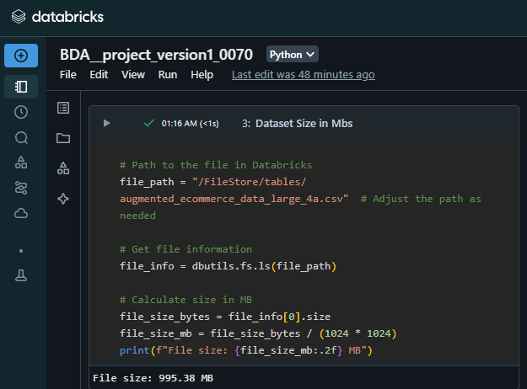
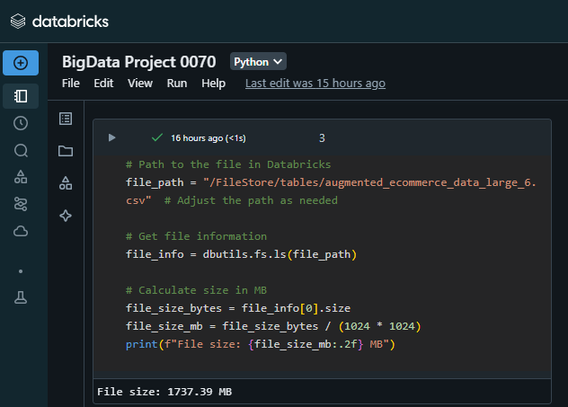
Data Collection and Data Augmentation

Slide 9
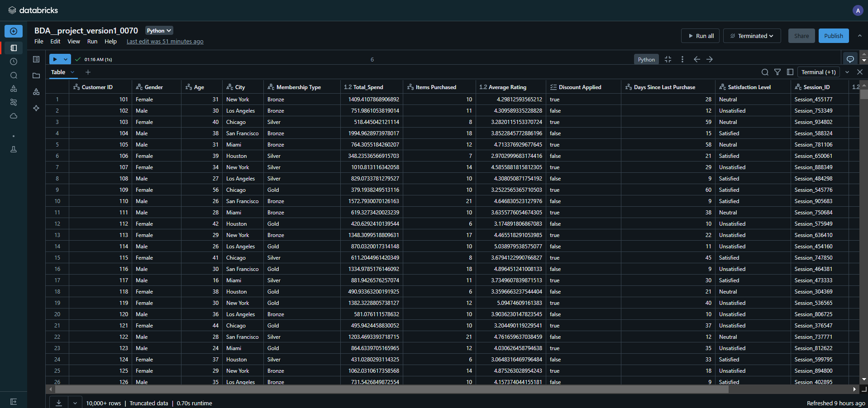
Dataset: E-commerce Customer Behavior Analysis

Slide 10
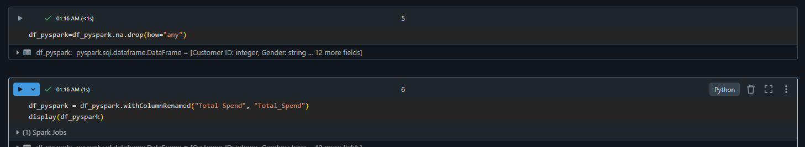
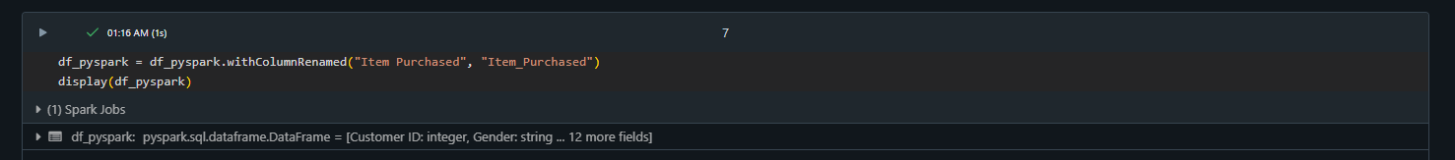
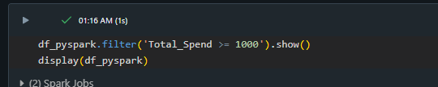
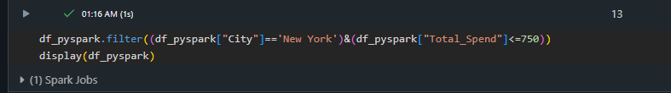
Basic Filtration and Cleaning

Slide 11
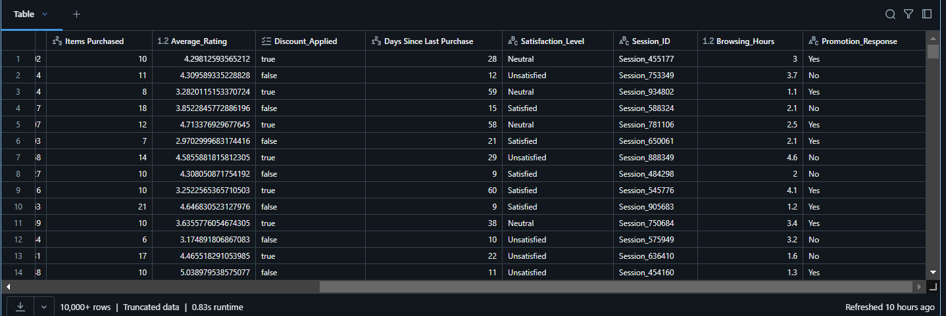
Data Set After Filtering

Slide 12
Machine Learning Functionalities Using MLib
PySpark provide us the functionalities to apply ML model, testing, training in an efficient way.
In this project the project has been analyzed with the help of two different Machine Learning Models
Linear Regression
K-Mean Clustering

Slide 13
Linear Regression
To perform the Regression Analysis, the data is divided into two steps:
Independent Variable Set
Dependent Variable Set
We are using Multi-Regression Analysis
y=alpha0+alpha1X1+alpha2X2+------+alpha(m)Xm

Slide 14
K-mean Clustering
Grouping the data based on similar traits into distinct groups
In our project, The customer are segmented into three distinct groups
→Satisfied → Indexed 0
→Neutral → Indexed 1
→Unsatisfied → Indexed 2

Slide 15
Pre-Modeling steps
Encoding Categorical Column
Encoding is of two types:
One Hot Encoding
Ordinal Encoding
In our project we have implemented Ordinal Encoding using String Indexer technique is used to indexed Categorial Column into Numeric Column.

Slide 16
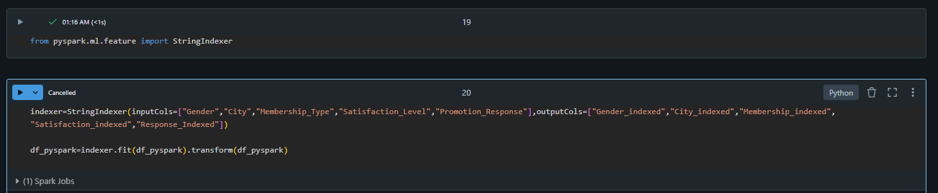
Ordinal Encoding

Slide 17
Pre-Modeling steps
Vector Assembler
We use Vector Assembler to Categories into columns into a single matrixlike, i.e., the independent Variable Set.

Slide 18
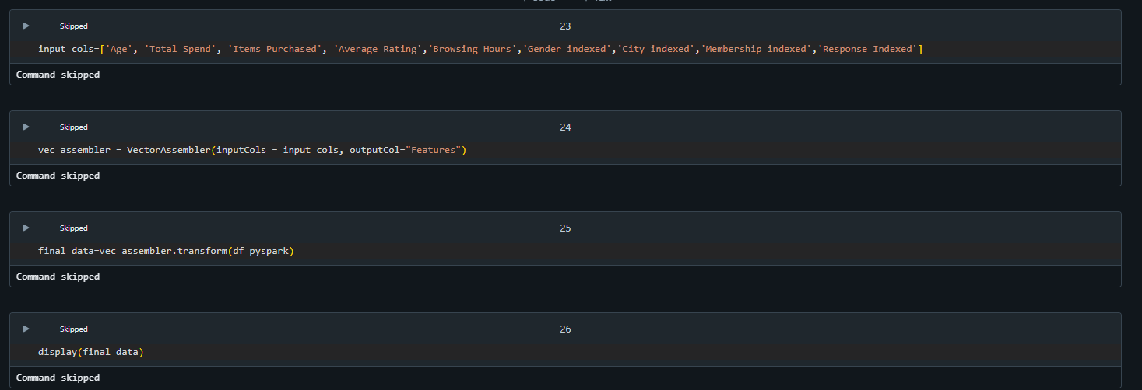
Vector Assembler

Slide 19
Final Modeling & Training
K-mean clustering and Linear Regression both are used respectively to predict better results and compare which model predict and analyze the customers data respectively.
K mean clustering technique succeeds in to predict better analysis as it segments the customer satisfaction based on data points to generate the better insights.
Similar Data points are Grouped into single cluster.
For Example: All the Customers that are Unsatisfied are grouped into a single cluster.

Slide 20
K-Mean Clustering
from pyspark.ml.clustering import KMeans
from pyspark.ml.evaluation import ClusteringEvaluator
kmeans = KMeans(featuresCol='Features',k=3)
model = kmeans.fit(final_data)
model.transform(final_data).groupBy('prediction').count().show()
predictions=model.transform(final_data)
data=predictions.groupBy('Satisfaction_Level','prediction').count()
display(data)

Slide 21
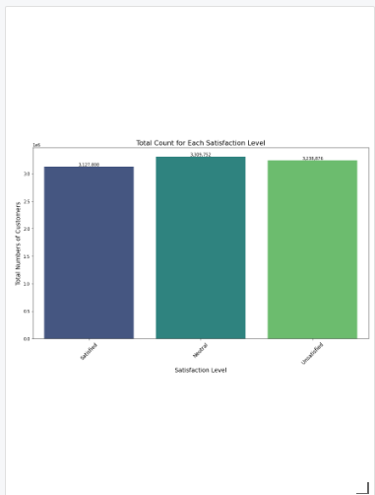
Visualization
Bar Graph:

Slide 22
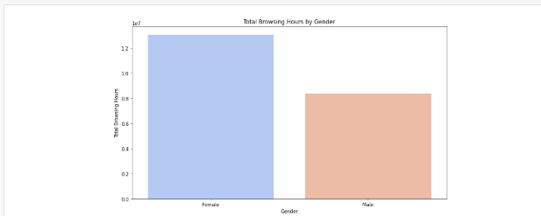
Visualization
Bar Graph

Slide 23
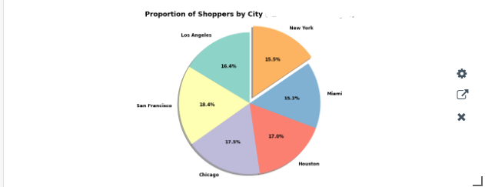
Visualization → Pie Chart

Slide 24
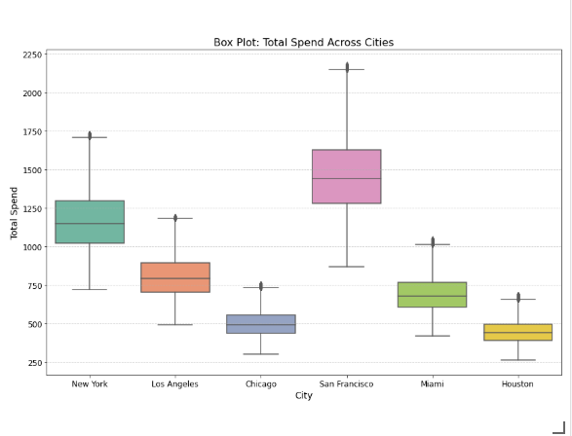
Visualization

Slide 25
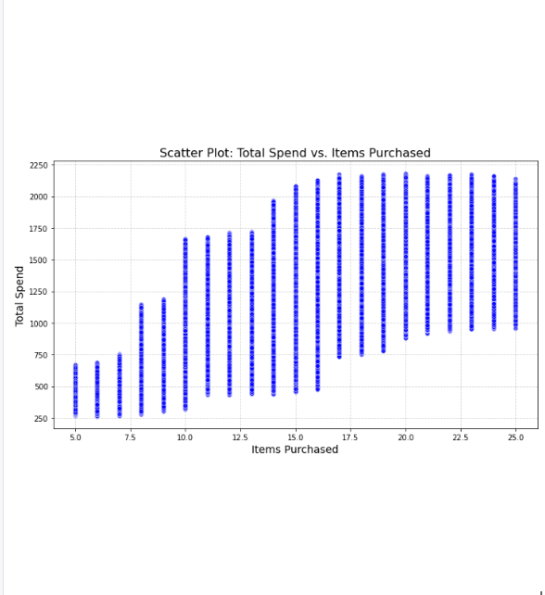
Visualization → Scatter Plot

Slide 26
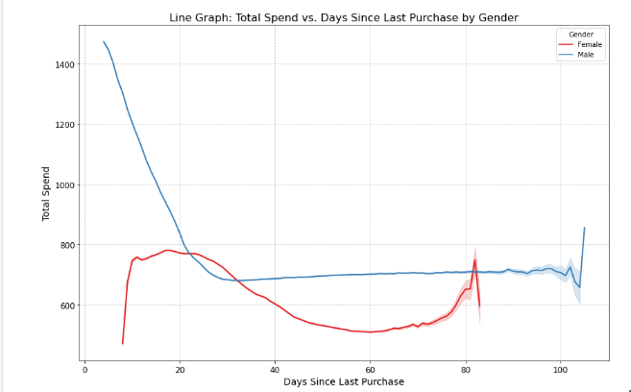
Visulaization

Slide 27
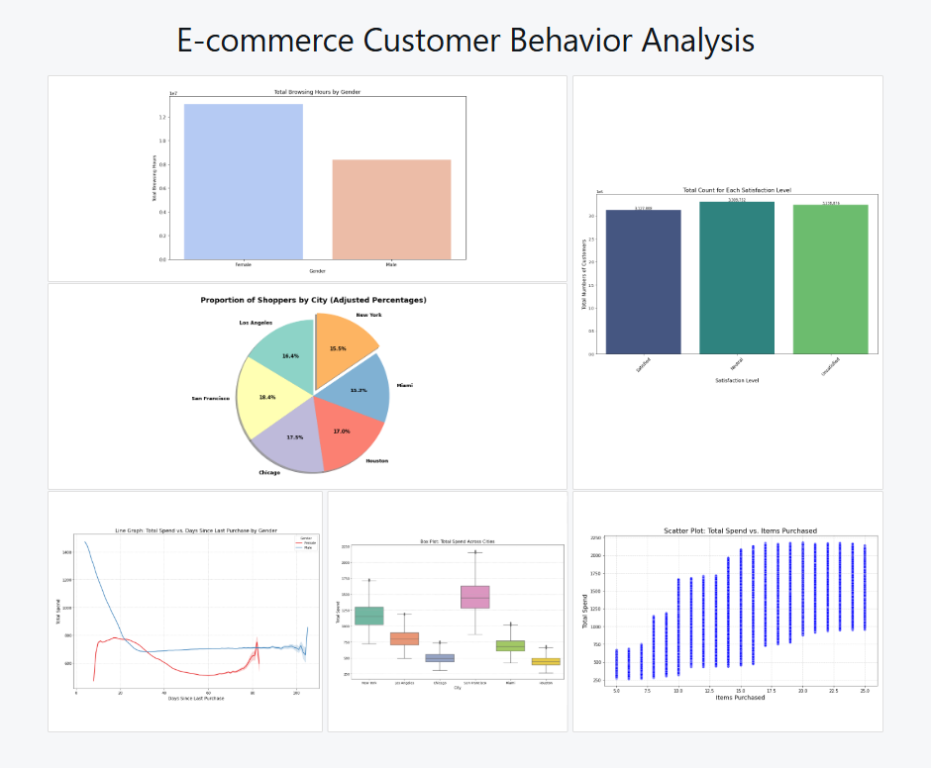
DashBoard

Slide 28
Challenges faced
Finding a suitable data set as per Requirements.
Handling large amount of data of 995.38 and 1.8 GB of data respectively
Decision of using appropriate Algorithm
Ensuring accurate results based on K-Mean Clustering
Managing Resources

Slide 29
Thank You Any Questions?

